Slide 1
Biology 101: Introduction to Ecology Populations
SECTION 2
DR. ANAND
APRIL 24, 2017

Slide 2
Ecology
Ecology = the study of factors that influence two key variables:
Abundance of organisms = how many?
Distribution of organisms = where are they?

Slide 3
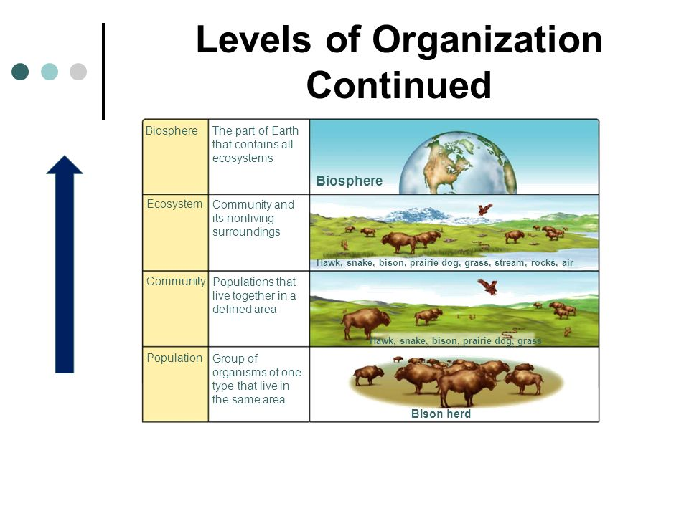
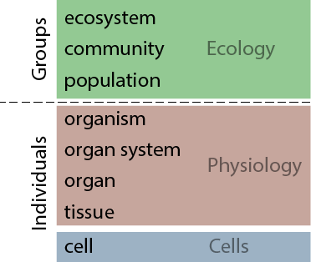
Biological Organization

Slide 4
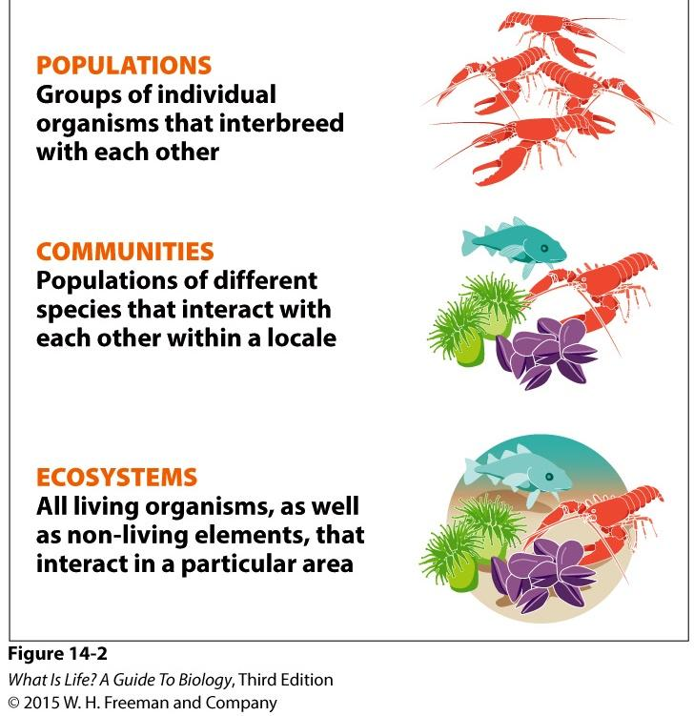
Ecological Organization

Slide 5
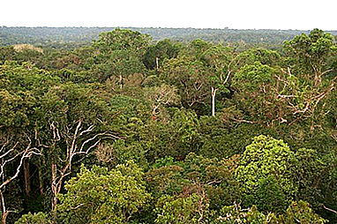
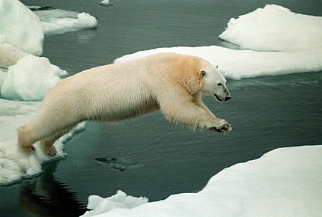
Species vs. Populations
A population is a group of individuals of the same species living & interacting in a local area
The definition of the “local area” varies by species
e.g., insects living in jungle canopy may have different populations in the top of each tree, but polar bears may be considered to consist of a single population spread throughout the Arctic

Slide 6

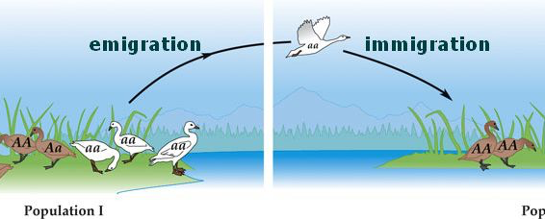
Population Growth
Population growth is determined by:
Birth rate ↑
Immigration rate ↑
Death rate ↓
Emigration rate ↓
If stable population, then B+I = D+E
If population is growing, then B+I > D+E
If population is shrinking, then B+I < D+E

Slide 7
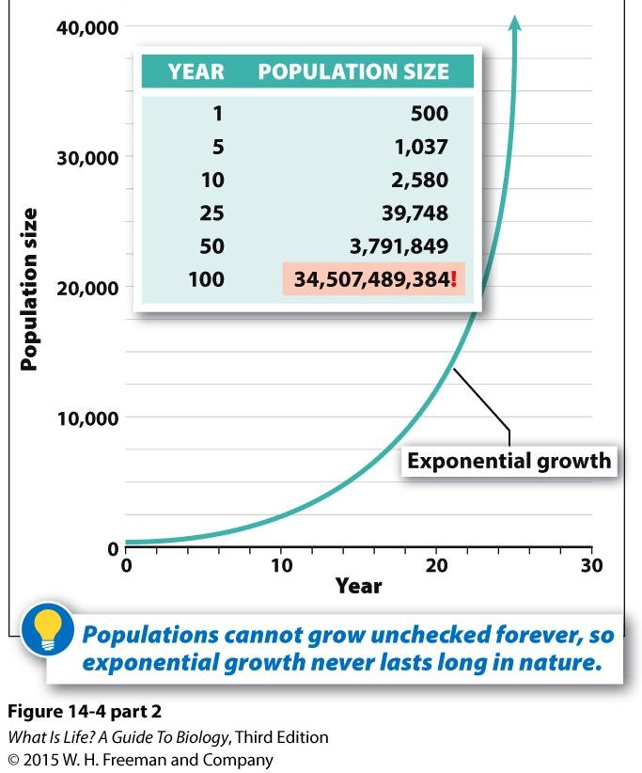
Exponential Growth
Each individual produces more offspring than needed to replace itself
Natural populations may experience periods of exponential growth, but not sustainable

Slide 8
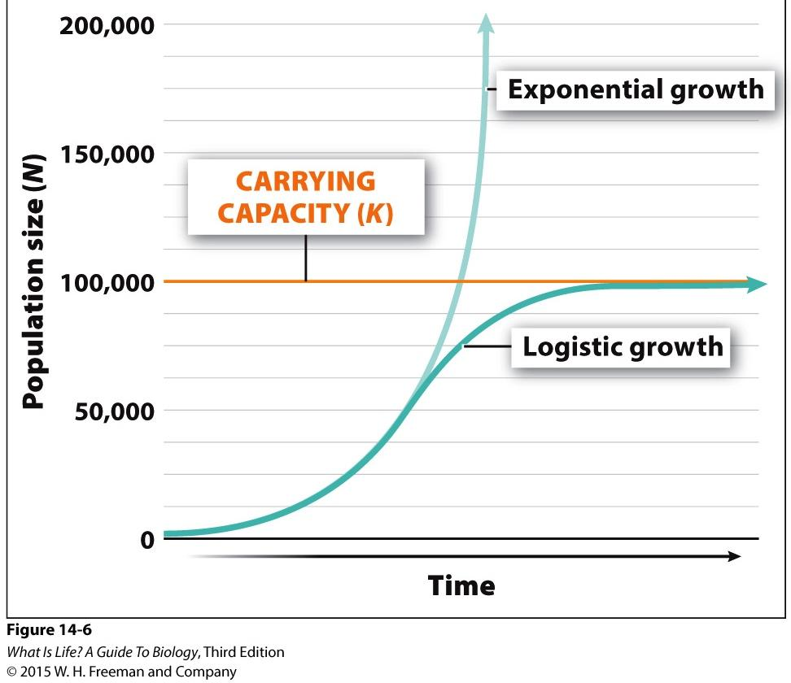
Logistic Growth
Population grows more slowly as it nears carrying capacity
Carrying capacity is the population size that a habitat is capable of sustaining over time
Factors that influence carrying capacity include availability of resources, climate, number & size of other populations in the community, etc.

Slide 9
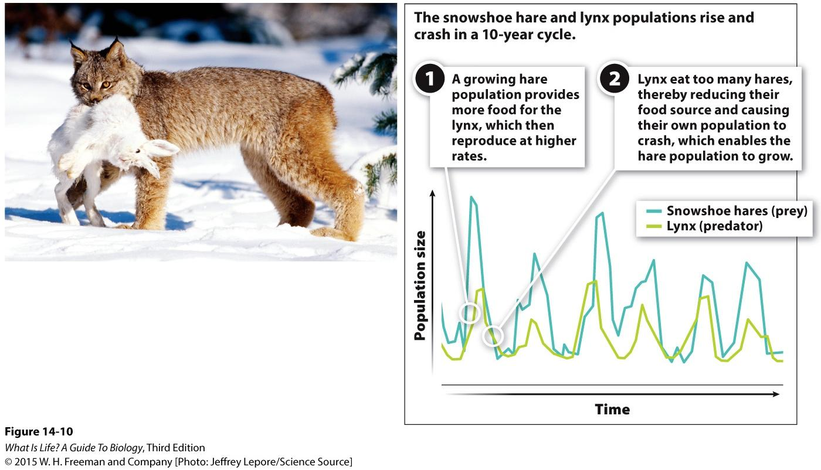
Oscillations
Cyclic variation in population size
Often periods of exponential growth followed by crashes
Involves at least two populations tied closely together

Slide 10
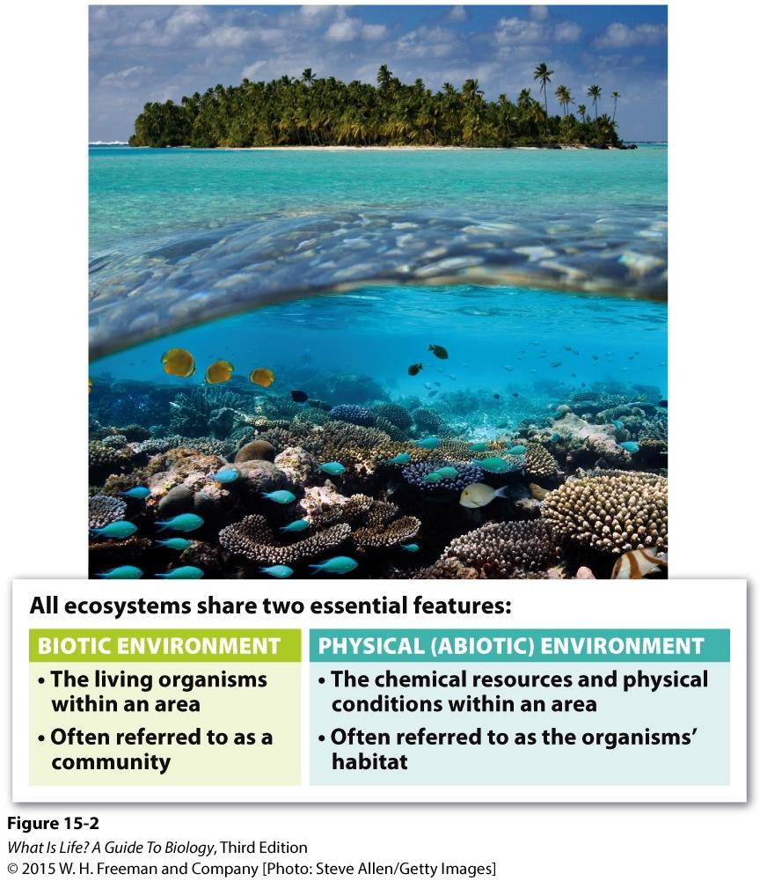
Factors Affecting Growth
Biotic Factors = Other organisms that affect population growth
Prevalence of disease
Abundance of food (prey)
Abundance of predators
Abiotic Factors = Factors affecting population growth that are not due to other organisms
Weather
Climate
Landscape & terrain

Slide 11
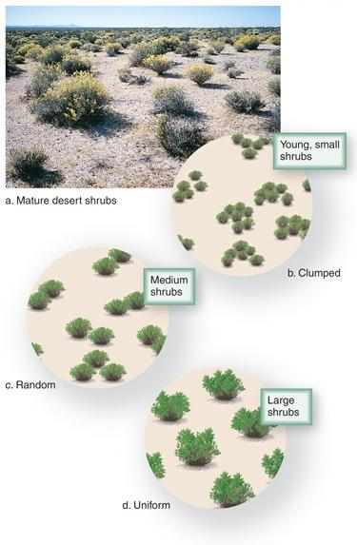
Population Distribution
Population density describes the distribution of a population throughout the habitat
Random = There is no discernable pattern
Clumped = Organisms in a population are more likely to be found near other organisms in the same population
Uniform = A population is distributed into discrete territories throughout the habitat to maximize space between members
Growth is affected by density

Slide 12
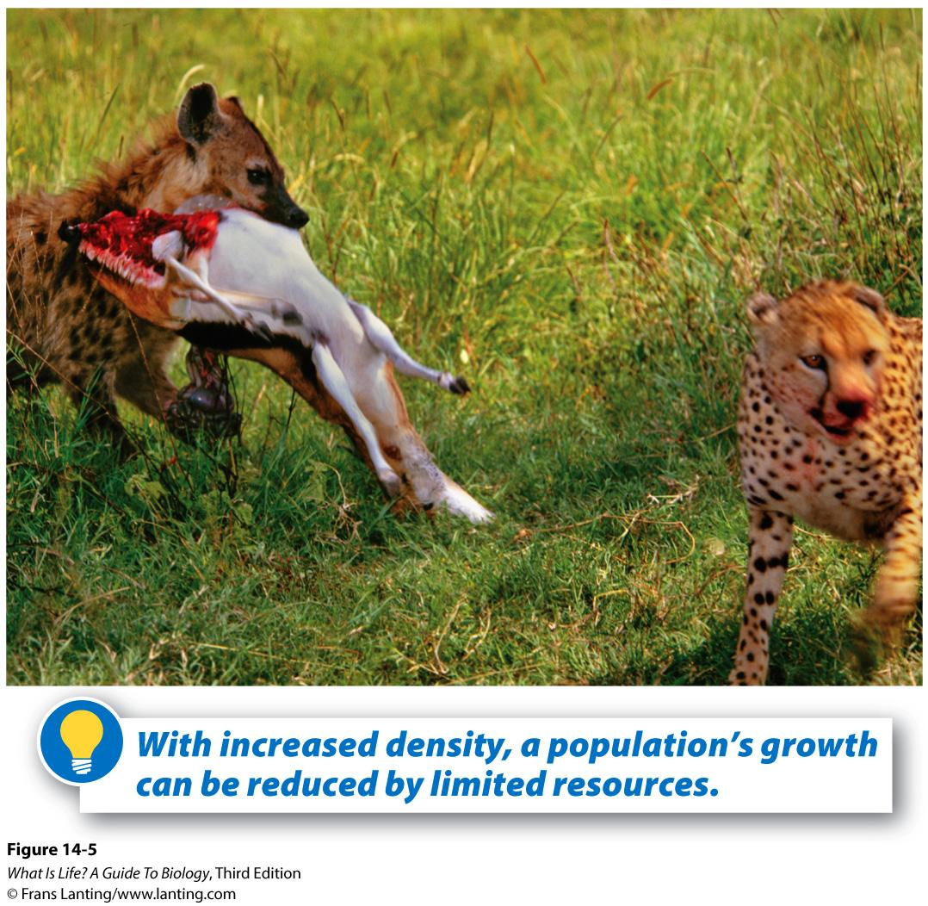
Density-Dependent Growth
Density-dependent factors affecting population growth are those that vary depending on the size & distribution of the population
e.g., availability of food, predation risk, number of nesting sites
Density-independent factors affect all sizes and distributions of populations equally
e.g., climate, weather

